Slide 1


Data-Driven Recruitment System
Optimizing Biased Talent Acquisition Through Data-Driven HR Analytics

Slide 2
Dashboard Implementation

Slide 3







Project Workflow
Predictive Machine Learning
A tuned XGBoost model processes the input to determine the approval probability.
Data Collection
Results Visualization
Candidate data is entered manually through an interactive form in the Streamlit sidebar.
The final results are displayed in real-time: "Hired/Not Hired" status.
Step 2
Step 1
Step 3

Slide 4
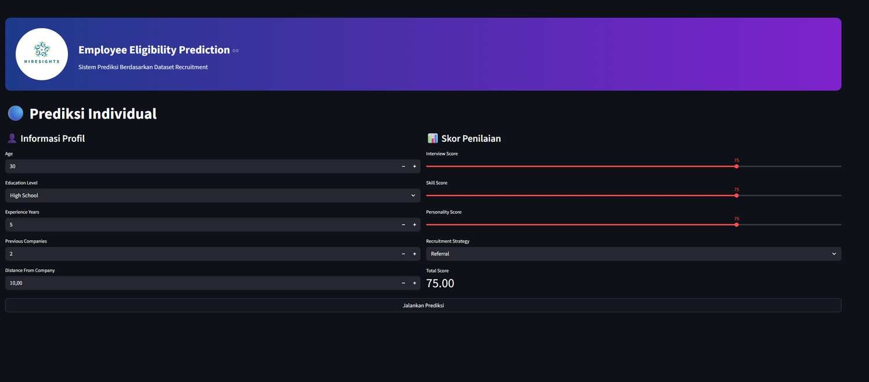

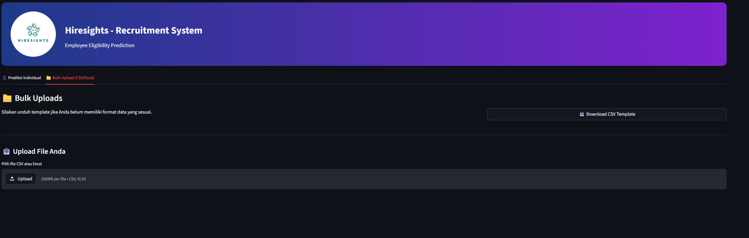
Mainpage Overview
GITHUB
[click here]
Users can dynamically modify candidate parameters.
Input changes instantly update the prediction results.

